Slide 1


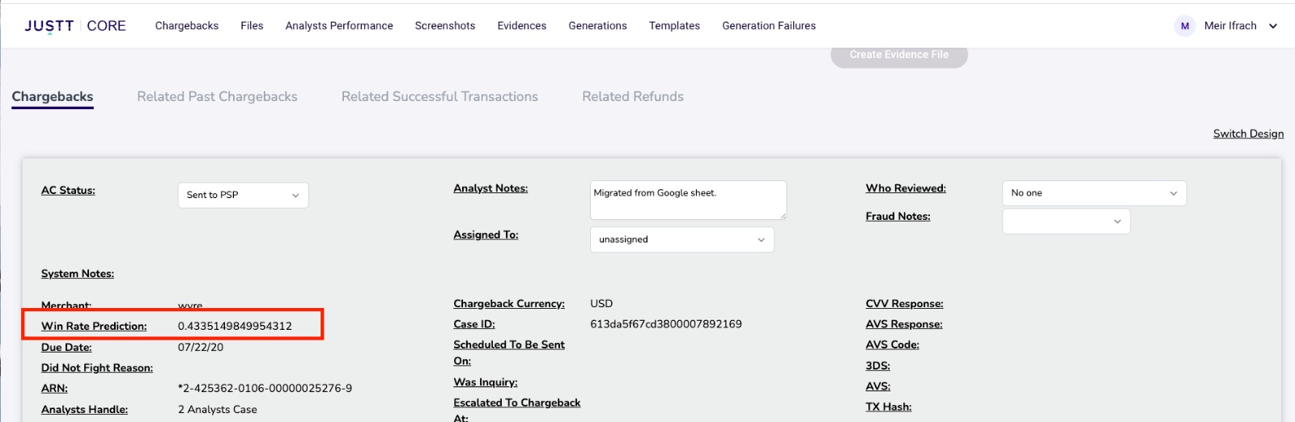
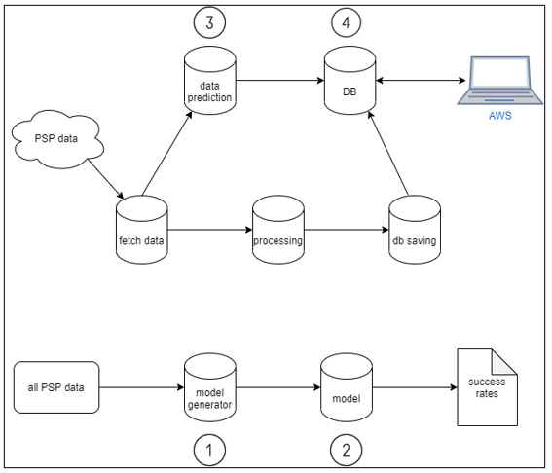
Chargeback Winnability Prediction
Inbar Siloni, Ido Pe’er
Advisor: Meir Ifrach
Introduction
The Analyst Tool
Justt is a fin-tech company that specializes in fighting chargebacks. A chargeback is a process where a cardholder denies the transaction and claims his money back. The bank usually gives the cardholder his money and then claims it from the merchant. JUSTT builds cases that prove that the chargebacks are faulty, and the claim is false, so the merchant keeps the money from the transaction. In this project, we will build a model that predicts the winnability of cases in one of the bigger merchants that uses JUSTT's service.
Here is how the analyst tool looks like. Every case has its data points, which the analyst scan and use in order to build the evidence file to fight the chargeback. The red rectangle shows the new feature we added to the tool in order to give the analysts idea about the expected win rate.
Motivation
To fight chargebacks, an analyst at JUSTT scans the transaction's information and builds evidence that proves that the cardholder indeed purchased the good/item (and the credit card wasn't stolen or any other excuse). This process takes time and resources from the company. To save these resources, we want to predict a case's winnability based on the transaction's data. Doing that will help JUSTT manage its resources and prioritize to fight cases that will more likely yield a win. In this project, we focused on one of the bigger merchants that JUSTT deals with, but if it will work fine, we can expand the model to other merchants.
Conclusions
Methodology
This project involved working with JSON files while building a machine learning model which we have never done before. And using docker, node.js and react in order to use the model as a feature for analysts in JUSTT.
During the project, we have dealt with several challenges:
1. We had a problem with getting the data without exposing JUSTT private information.
2. There was a problem converting properly the data from csv to JSON and back, so we had to train the model on the JSON file and don’t use csv.
3. Learning from scratch how to use Docker, Node.JS and React in order to assimilate the model to the analyst tool.
Our final project composes of two parts: Training a model and assimilating the model's predictions as a feature in the analyst tool.
-Collecting the data from JUSTT internal system.
-Training an ML model on the data using Jupyter Notebook.
-Creating a staging working environment and adding the model's prediction for every case to it. This stage was made using k8s, docker, react node.js and mongoDB
Workflow
Future Work
1. Collect the data
2. Clean the data
3. Train the model
4. Check which ML algorithm yielded the most accurate results and choose it for making the predictions.
5. Add the model's prediction to the analyst tool
1. Continue improving the model.
2. Using AWS functions in order to update the data with more cases and retraining the model.
3. Create a model for other merchants that work with JUSTT (other than the biggest one we chose to work on)
Order online at https://www.postersession.com/order/

